Slide 1
AGILE AND SCRUM
Aakash Gupta M

Slide 2
What is agile?
Imagine planning a road trip… Instead of deciding every single stop in advance, you stay flexible, adjust based on traffic, weather, and what everyone wants. That’s Agile—a way of working that’s flexible, fast, and customer-focused!
Key Ideas of Agile:
Teamwork & Collaboration – Everyone works together and communicates openly.
Small & Quick Steps – Work is done in short, manageable cycles.
Customer First – Get feedback, make changes, and improve continuously.
Embracing Change – Plans adapt as new ideas or challenges come up.

Slide 3
Why Agile?Traditional methods wait months (or years) for a final product. Agile delivers useful features step by step, just like building a house room by room instead of all at once.
Key Ideas of Agile:
Teamwork & Collaboration – Everyone contributes and communicates openly.
Small & Quick Steps – Work is divided into short cycles (like making small pit stops).
Customer First – Instead of guessing what people want, Agile teams get feedback and adjust.
Embracing Change – Plans can shift, and that’s okay!

Slide 4
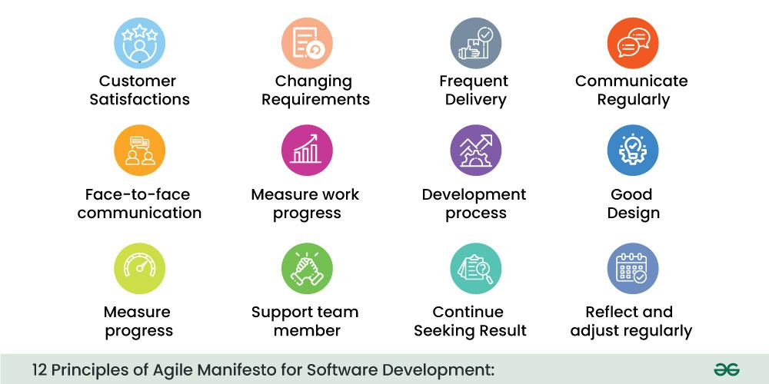
aGile principles

Slide 5
Advantages of agile
Faster Delivery
Flexibility & Adaptability
Better Collaboration
Higher Customer Satisfaction
Reduced Risks
Higher Quality

Slide 6
Disadvantages of agile
Lack of Predictability
Scope Creep
Requires Active Collaboration
Not Ideal for Large Projects
Documentation Challenges
Dependence on Skilled Teams

Slide 7
What is scrum?
Scrum is a framework within Agile that helps teams work efficiently by breaking work into small, manageable parts and continuously improving through feedback. Think of it like a rugby scrum—a team working together, adjusting, and moving forward in short, focused bursts. Key Elements of Scrum:
Sprints – Short, time-boxed work cycles (usually 1-4 weeks).
Scrum Team – Includes a Product Owner, Scrum Master, and Developers working together.
Daily Stand-ups – Quick daily meetings to discuss progress and obstacles.
Backlog – A list of tasks/features to be completed.
Sprint Review & Retrospective – End-of-sprint meetings to review work and improve.

Slide 8
Advantages of scrum
Faster Delivery
Increased Flexibility
Improved Collaboration
Better Product Quality
Higher Customer Satisfaction
Continuous Improvement
Better Risk Management

Slide 9
Disadvantages of scrum
Requires Experienced Team Members
Difficult to Scale for Large Teams
Frequent Changes Can Cause Scope Creep
High Commitment Needed from Team
Time-Consuming Daily Meetings
Lack of Detailed Documentation
Not Suitable for All Projects

Slide 10
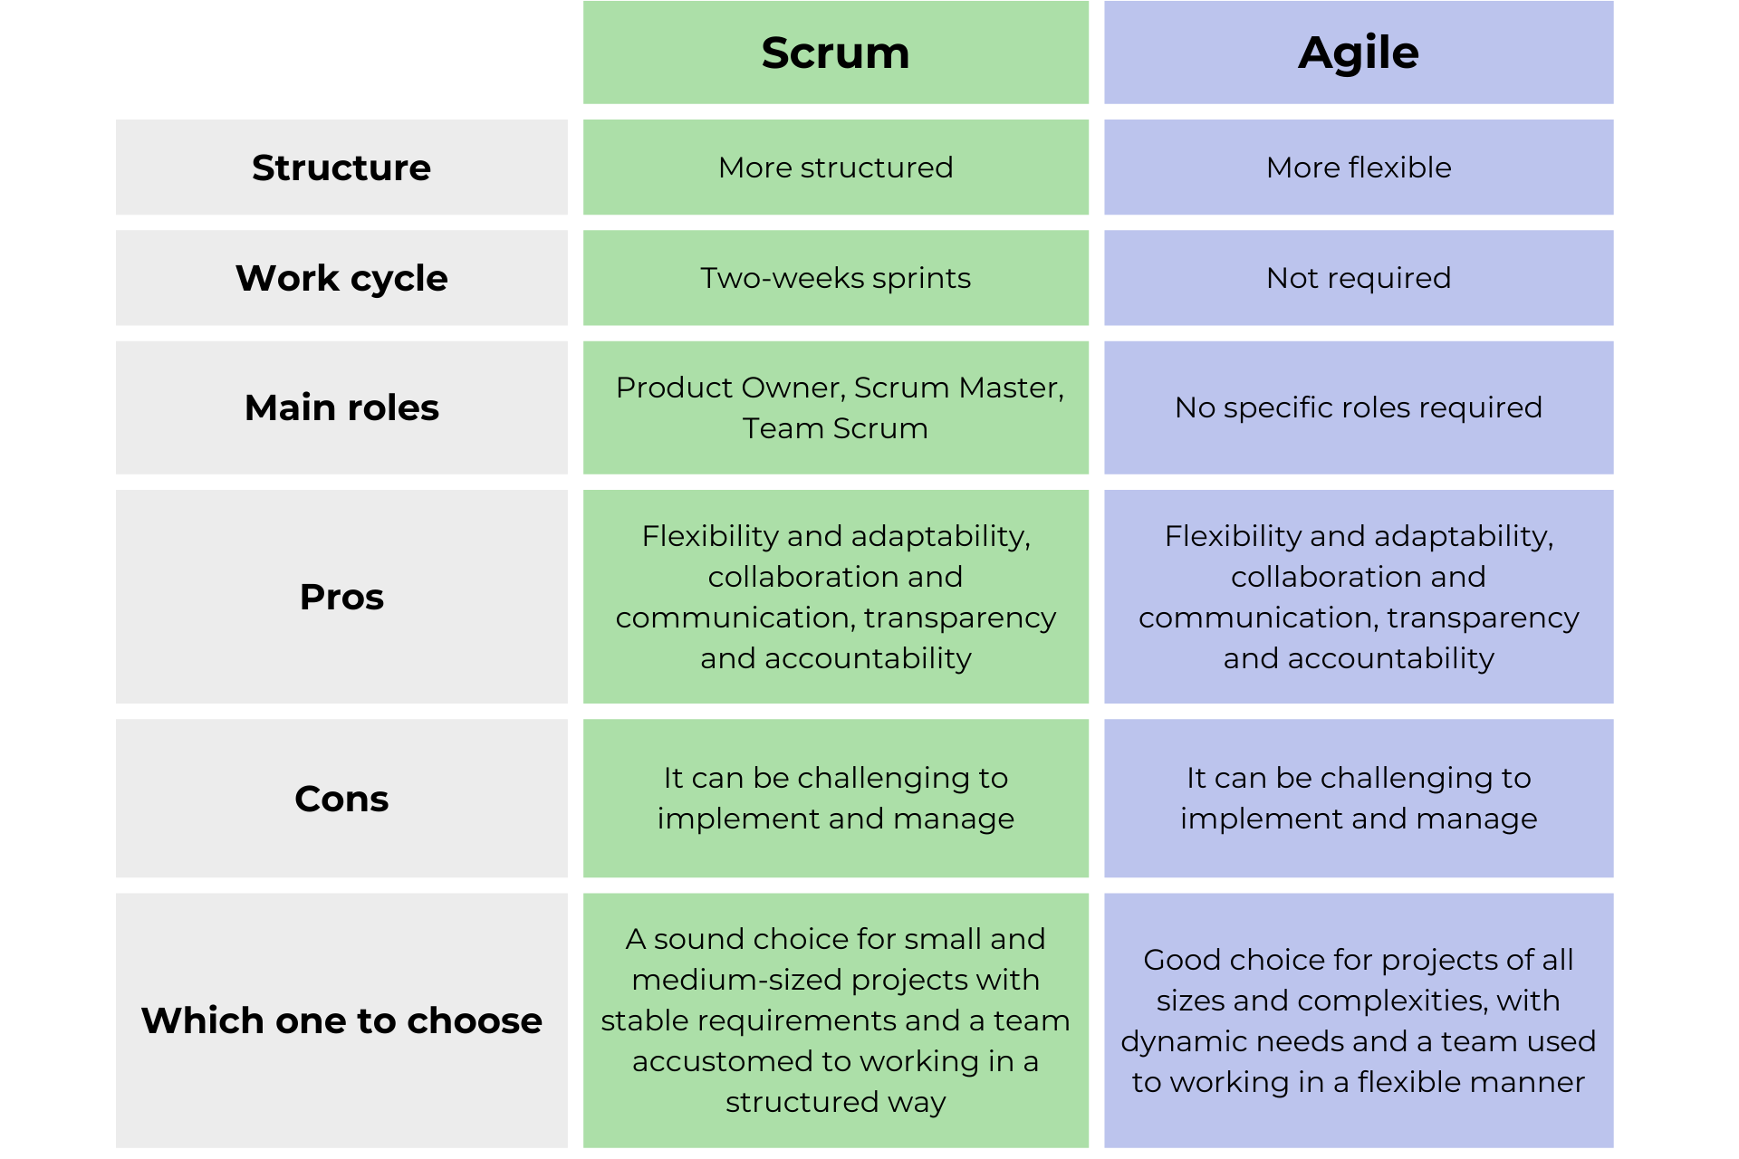
Agile vs Scrum

Slide 11
Thank You

